Slide 1
An Orientation of the Human Body
Chapter 1

Slide 2
What’s the difference?
Anatomy
Studies structure of body parts and their relationships to one another
Physiology
How the body parts work
One depends on the other
Ex: Structure of bone allows it to carry out its function of support

Slide 3
Levels of Organization
Chemical
Cellular
Tissue
Organ
Organ System
Individual

Slide 4
Necessary Life Functions
Maintaining Boundaries
Internal environment has to be separate from external environment
Selectively permeable membrane of cell
Body protected by skin
Movement
Could be body movement or
moving things through our body

Slide 5
Necessary Life Functions
Responsiveness
Ability to sense change in environment and respond
Hand on stove
Level of carbon dioxide in blood
Digestion
Eat food and obtain
nutrients

Slide 6
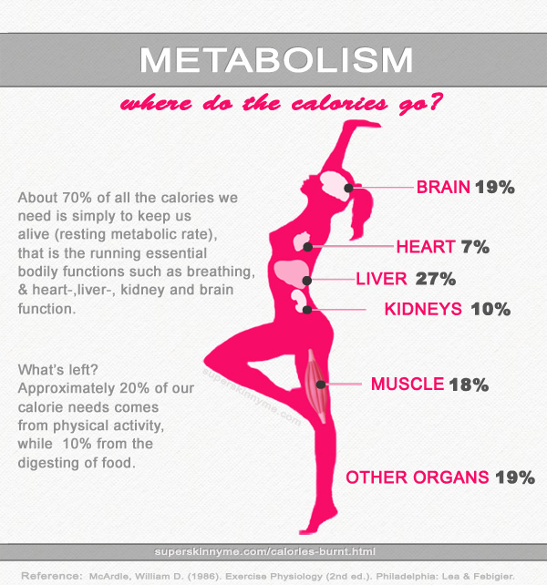
Necessary Life Functions
Metabolism
All chemical reactions that
occur in the body
Breaking down
substances
Synthesizing structures
Cellular respiration
Excretion
Removal of waste

Slide 7
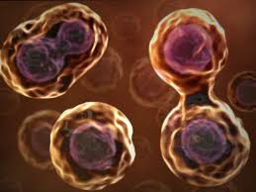
Necessary Life Functions
Reproduction
Cellular level
Heal and Grow
Organism Level
Produce offspring
Growth
Increase in size

Slide 8
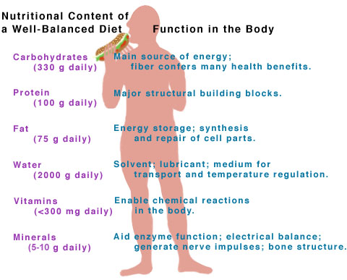
Survival Needs
Nutrients
For energy and cell building
Carbs, proteins, minerals,
vitamins etc.
Oxygen
Cellular respiration requires oxygen
Water
All reactions take place in water
60-80% of body weight

Slide 9
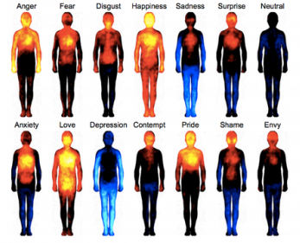
Survival Needs
Normal Body Temperature
98.6º F
Too cold – reactions slow
Too hot – enzymes
break down
Atmospheric Pressure
Force air exerts on body

Slide 10
Homeostasis
Maintenance of stable internal environment
Temperature
Blood Pressure
Heart rate
Glucose levels
Oxygen levels
Components of feedback system
Receptor – senses change (thermometer)
Control Center – Analyzes input (thermostat)
Effector – Changes to get back to setpoint (heater)
Big Bang

Slide 11
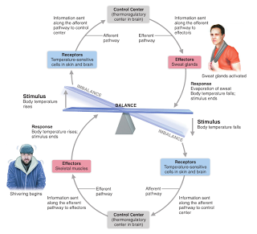
Negative Feedback
Returns body to
normal conditions
Circular

Slide 12
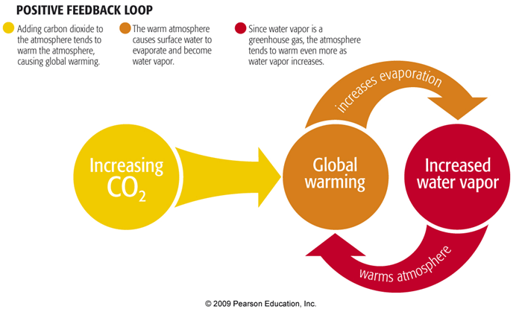
Positive Feedback
Continues away from normal
Straight Line

Slide 13
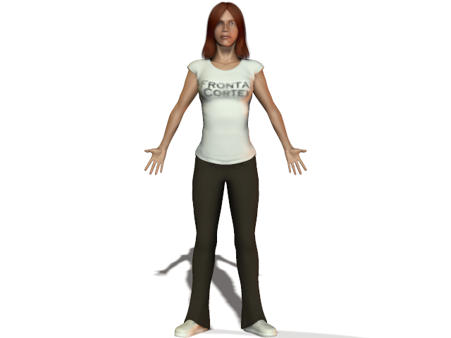
The Language of Anatomy
Anatomical Position
Standing
Feet slightly apart
Palms forward

Slide 14
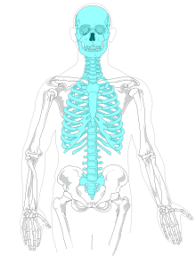
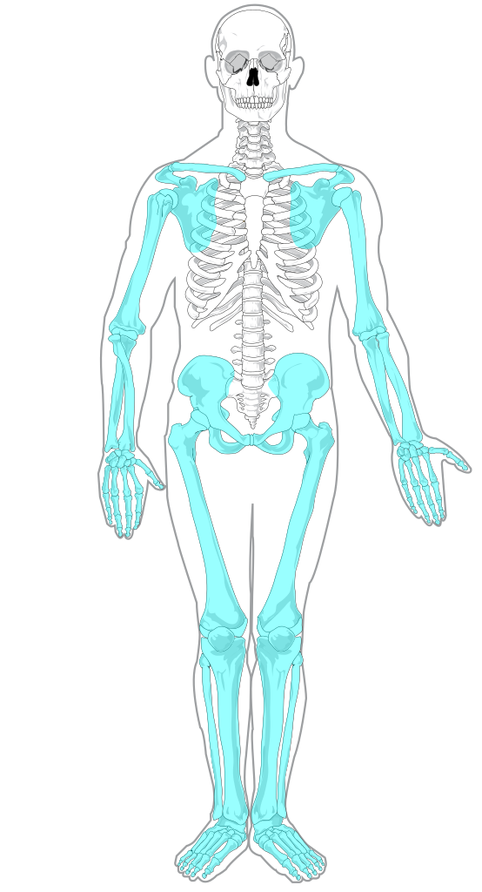
The Language of Anatomy
Regional Terms
Axial
Head, neck and trunk
Appendicular
Appendages
Arms and legs

Slide 15
The Language of Anatomy

Slide 16
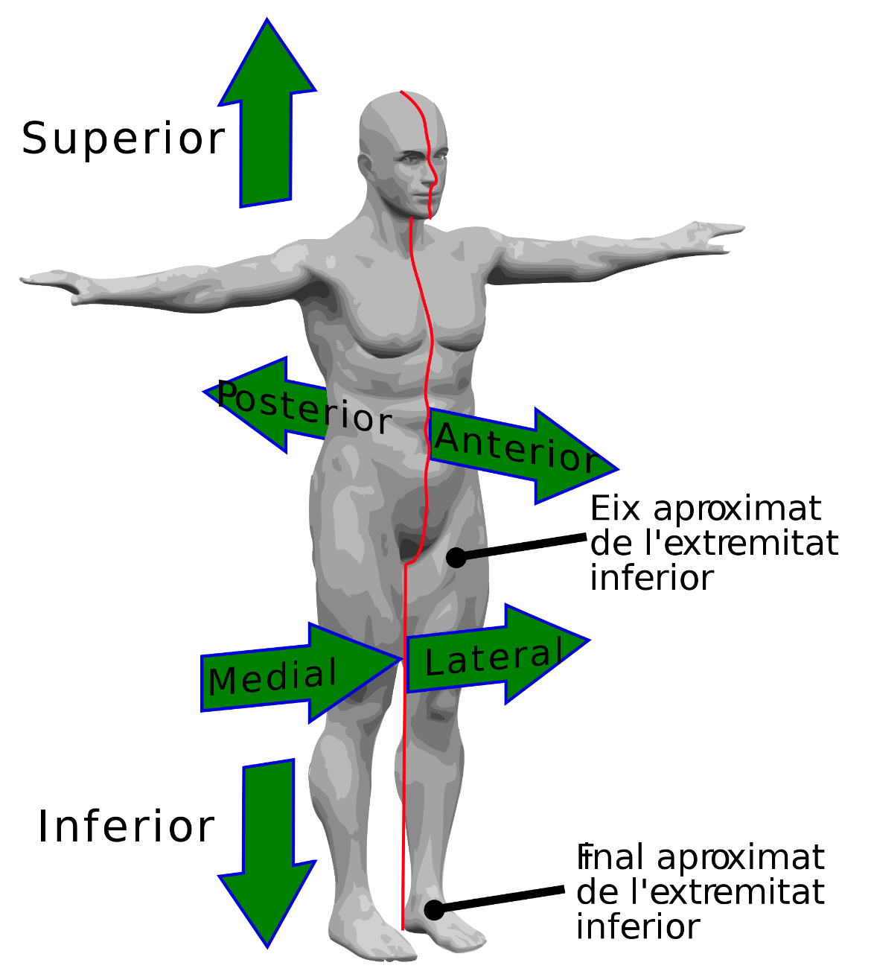
The Language of Anatomy
Directional Terms
Superior
Toward the head
Inferior
Away from head

Slide 17
The Language of Anatomy
Directional Terms
Anterior
Ventral
Toward the front
Posterior
Dorsal
Toward the back

Slide 18
The Language of Anatomy
Directional Terms
Medial
Toward the midline
Lateral
Away from the midline

Slide 19
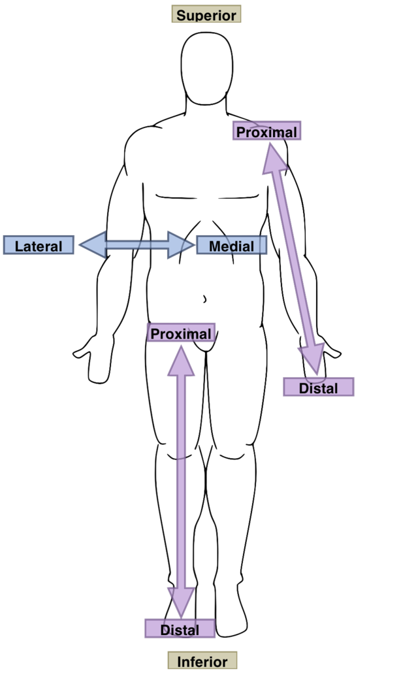
The Language of Anatomy
Proximal
Closer to point of origin
Distal
Farther from point of origin

Slide 20
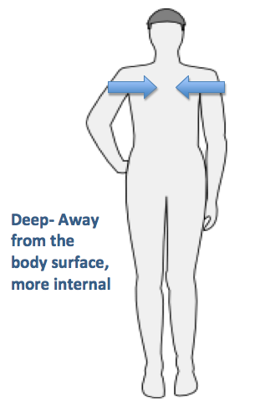
The Language of Anatomy
Superficial
Toward the surface
Deep
Away from surface
More internal

Slide 21
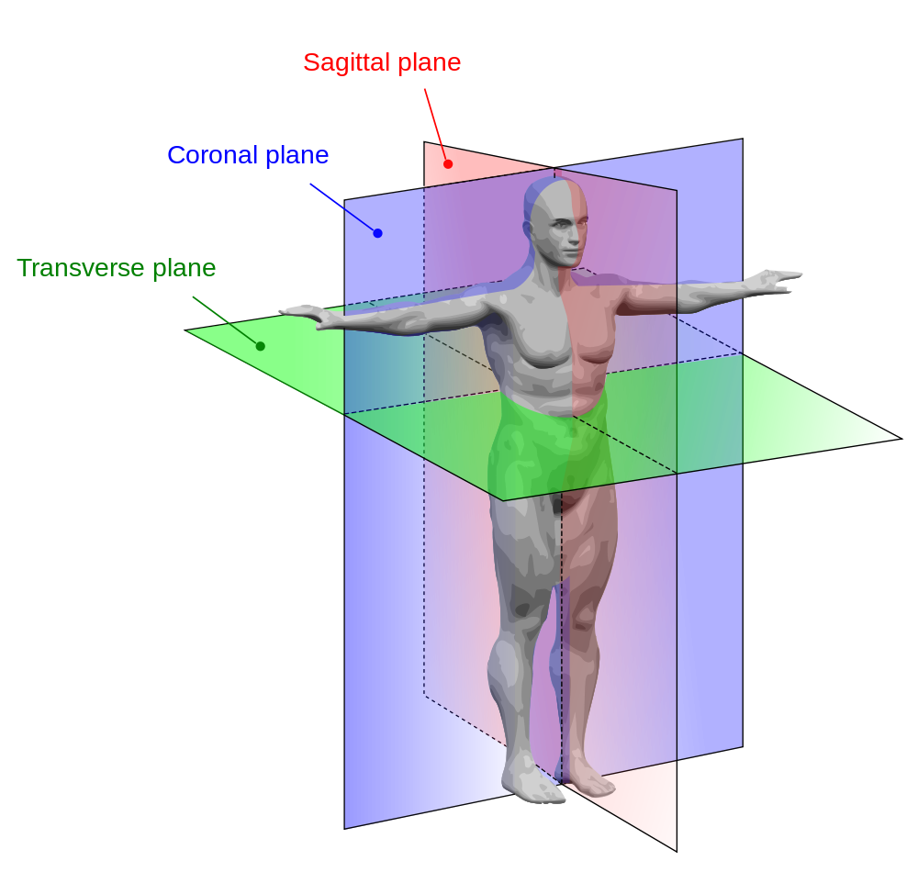
Body Planes and Sections
Sagittal
Divides right and left
Coronal (Frontal)
Divides front to back
Transverse (Horizontal)
Divides top to bottom
Oblique
diagonal

Slide 22
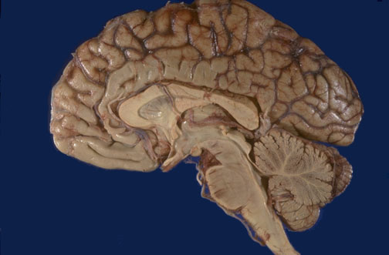
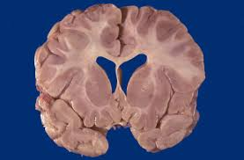
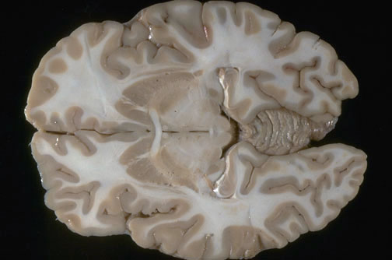
Body Planes and Sections
Brain MRI Sagittal
Right to left
Brain MRI Coronal
Front to back
Brain MRI Transverse
Upper to lower

Slide 23
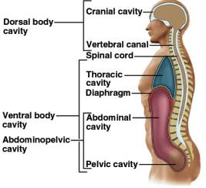
Body Cavities
A. Dorsal Body Cavity
Protects nervous
system organs
1. Cranial
Encases brain
2. Vertebral (Spinal)
Protects spinal cord

Slide 24
Body Cavities
B. Ventral Body Cavity
1. Thoracic Cavity
Pleural cavities (2)
Hold lungs
Pericardial cavity
Holds (houses) heart
2. Abdominopelvic Cavity
Separated from thoracic by diaphragm
Abdominal cavity
Stomach, intestines, spleen, liver etc.
Pelvic Cavity
Bladder, reproductive organs, rectum

Slide 25
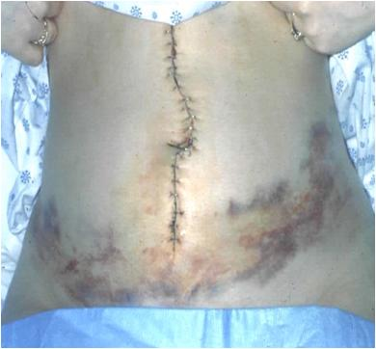
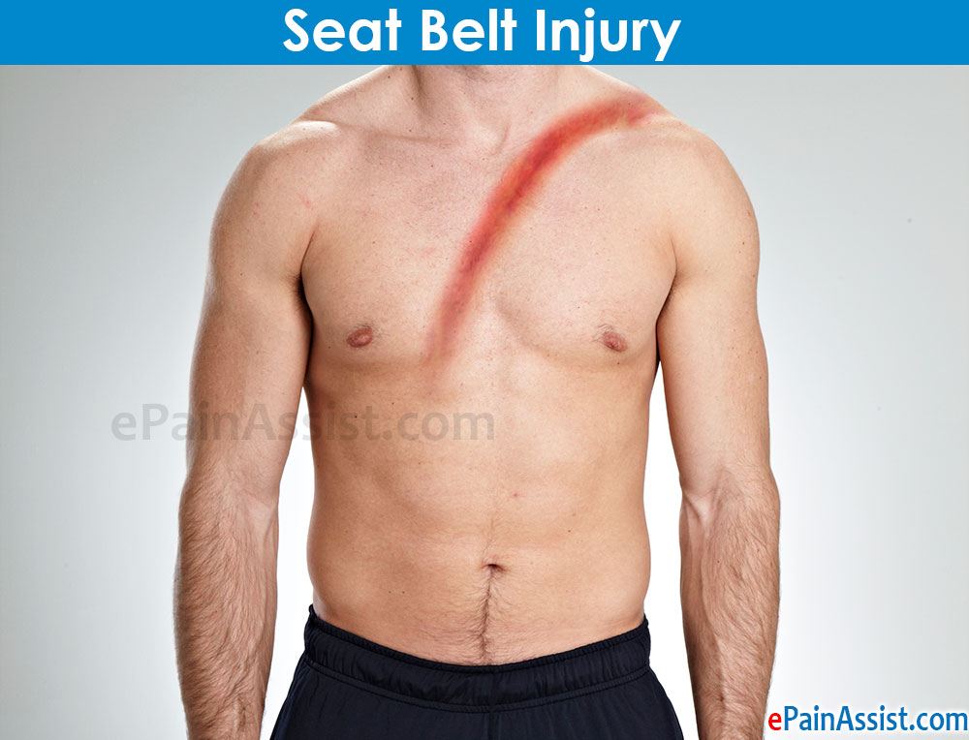
Homeostatic Imbalances

Slide 26
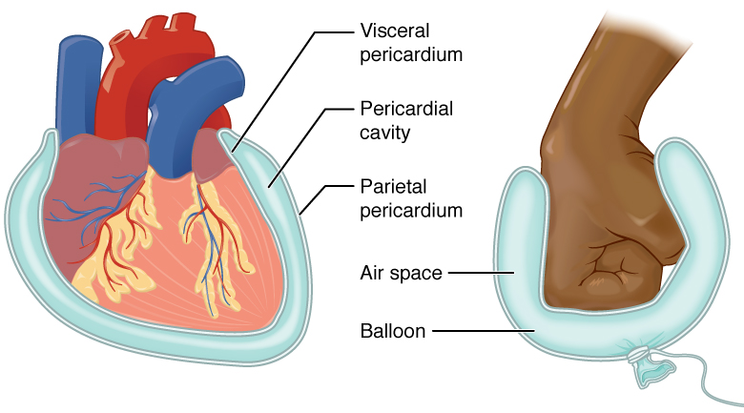
Membranes in Ventral Body Cavity
Serous Membrane
Double layered
Serous fluid reduces friction
1. Visceral
Covers organ
2. Parietal
Lines cavity wall

Slide 27
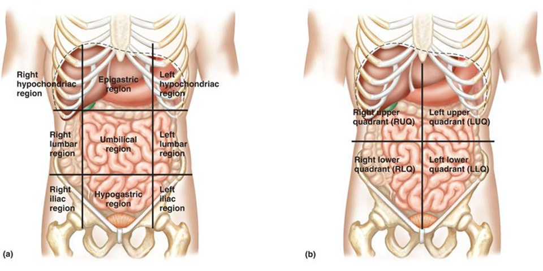
Abdominopelvic Regions & Quadrants
Too large
Doctor’s need way to locate structures

Slide 28
Other Body Cavities
1. Oral and Digestive
mouth
2. Nasal
nose
3. Orbital
Eyes
4. Middle Ears
5. Synovial
Elbows, knees, intervertebral discs

