Slide 1
Science Binder Guidelines

Slide 2
Binder Requirements
1. Title Page
2. Table of Contents
3. All pages numbered in upper right-hand corner.

Slide 3
Title Page
The Title Page must include:
The name of the class
The period number
Your first and last name
Your Title Page should be
the first thing I see!

Slide 4
Example of Title Page

Slide 5
Extra Credit
The only way to earn extra credit is on your title page.
If you type and print your page like the example, you will earn 2 points.
If you do your own artwork and make it class-related, you will earn up to 4 points.

Slide 6
Table of Contents
Include all pages in the Table of Contents
The first three pages should be:
Course Syllabus
Class Rules
Lab Safety Rules
The remainder of the pages should be in order as you complete them. They should be in chronological order.

Slide 7
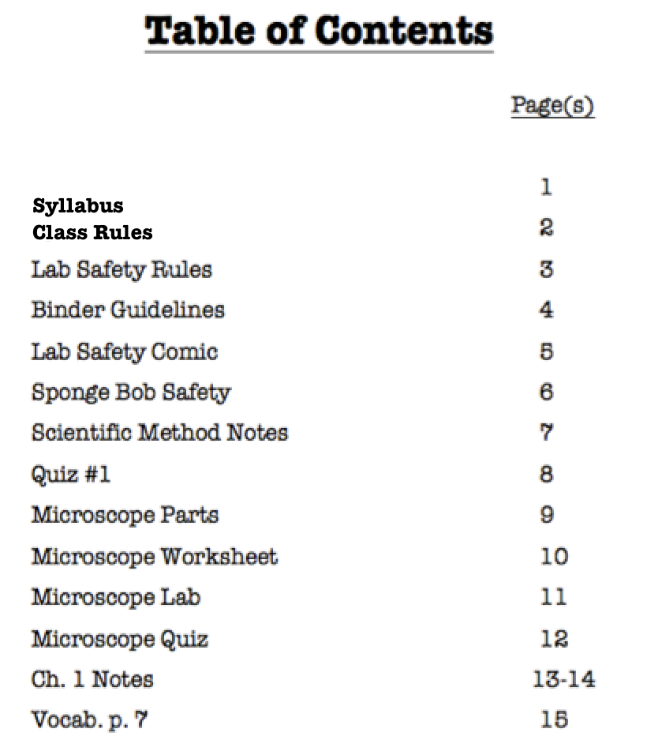
Example of Table of Contents

Slide 8
Number all pages in upper right-hand corner.
This should be self-explanatory.

Slide 9
Binders will be graded…
Once per quarter.
Your grade will be determined by following the requirements, neatness, and completeness.
Extra credit will be given if you show extra effort on your Title Page

Slide 10
Keeping a Binder is Important in This Class!
Your binder is worth 10% of your grade.
You will turn it in twice a semester, so make sure it’s done properly.
If you don’t turn it in, your grade will drop an entire letter grade!

